Slide 1

Mini project-II
E-SHOPPERS
DEPARTMENT OF COMPUTER SCIENCE ENGINEERING AND APPLICATIONS
Institute Of Engineering and Technology

Slide 2
Submitted By:
Pratibha Dixit
University Roll No.- 181500498
Section- G
Class Roll No.- 51
(181500498)
Supervised By:
Mr. Anand Prakash Gupta
Asst. Professor
Department of Computer Science & Applications

Slide 3
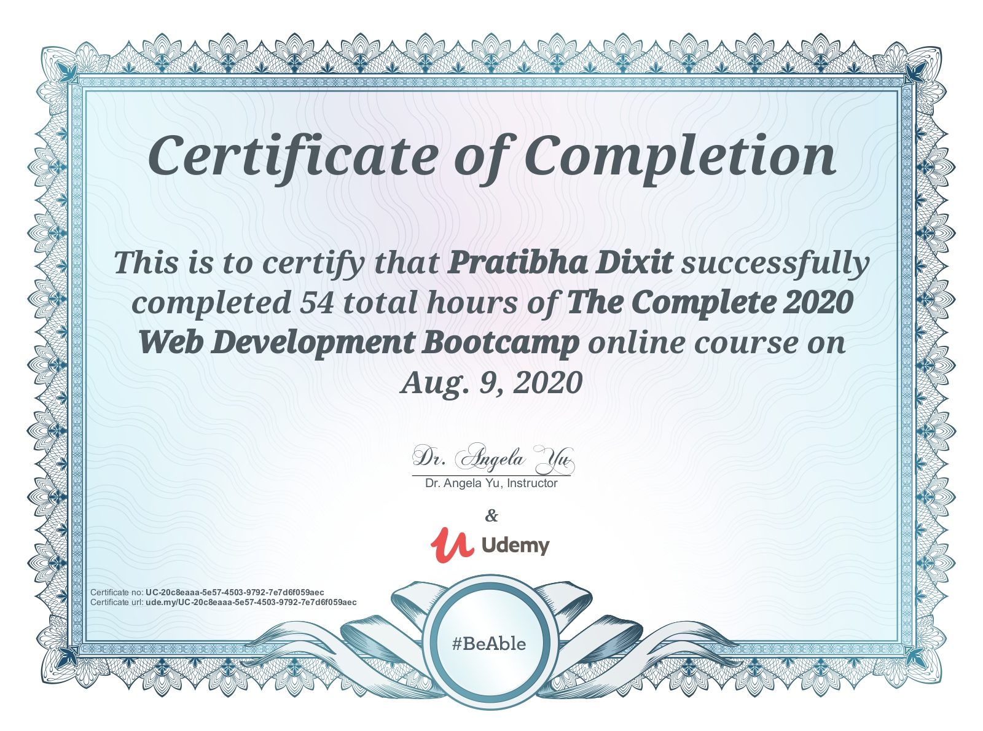
CERTIFICATES
Certificate of the Course attended by Pratibha Dixit:

Slide 4
PROJECT
E-SHOPPERS

Slide 5
Introduction-
“E-Shoppers” is a web-based project which is made for remote shopping or shopping through Internet.
Since the rise of large internet-based e-commerce sites, the growth of online shopping has been exponential, with a huge increase in the number of consumers choosing to buy online rather than in-store.
Even brands which no longer exist n the high street are often available online.

Slide 6
Synopsis-
The world is fast evolving, and so is everything that resides in it. The market system of the world today is no exception to this evolution.
Lots of businesses and trade stores now take their online presence seriously. The reason is not far-fetched; this is because most people now prefer to purchase their goods and services online rather than entering someone’s store to shop.
Now a day’s we can place the order for anything from our home. There is no need to go the shop of the things we want. The order can be placed online through Internet. The payment, the confirmation of purchasing; we can do everything we want. Now we can think that how the days have been changed with time.

Slide 7
Technologies Used-
PHP: PHP is a recursive acronym for "PHP: Hypertext Preprocessor". PHP is a server side scripting language that is embedded in HTML. It is used to manage dynamic content, databases, session tracking, even build entire e-commerce sites.
JavaScript:- JavaScript is a text-based programming language used both on the client-side and server-side that allows you to make web pages interactive. Where HTML and CSS are languages that give structure and style to web pages, JavaScript gives web pages interactive elements that engage a user.
Apache: Apache HTTP Server is a free and open-source web server that delivers web content through the internet. It is commonly referred to as Apache and after development, it quickly became the most popular HTTP client on the web.

Slide 8
SQL Server: The SQL Server is a relational database management system from Microsoft. The system is designed and built is to manage and store information. The system supports various business intelligence operations, analytics operations, and transaction processing.
CSS: CSS is used to define styles for your web pages, including the design, layout and variations in display for different devices and screen sizes.
Bootstrap: Bootstrap is a potent front-end framework used to create modern websites and web apps. It's open-source and free to use, yet features numerous HTML and CSS templates for UI interface elements such as buttons and forms. Bootstrap also supports JavaScript extensions.

Slide 9
Aim of this project-
This GUI based automated system a user want to purchase something then it only a mouse click away to purchase these products.
The e-commerce is mainly useful for who haven’t time to go shopping or for comfortably to the customers. Those are just entered into this website and bought they want at any time they can visit the web-site. Customer will choose different items like mobile, laptops, etc. This website is based on this formal.
This site gives all the information about the e-shopping to provide better service.

Slide 10
Context Level Diagram-

Slide 11
First Level DFD-

Slide 12
Second Level DFD-

Slide 13
Second Level DFD-

Slide 14
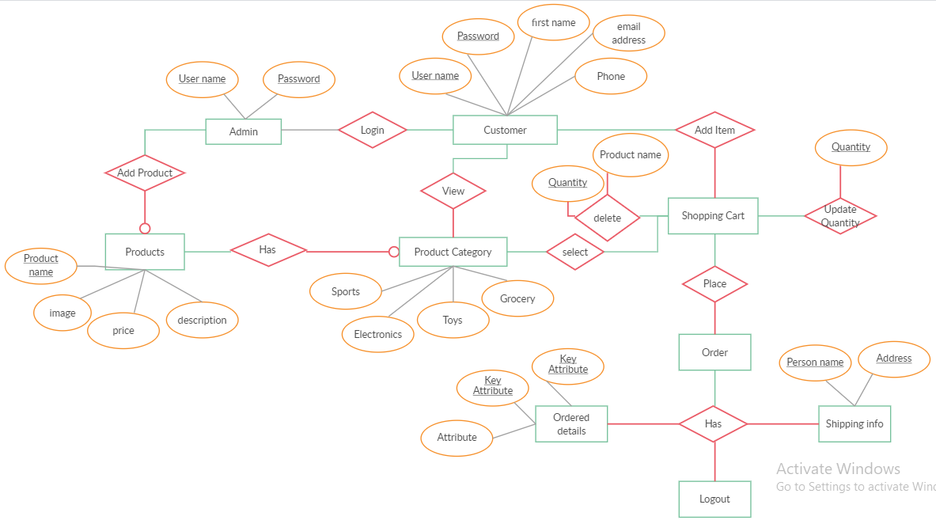
ERD (Entity Relationship Diagram)-

Slide 15
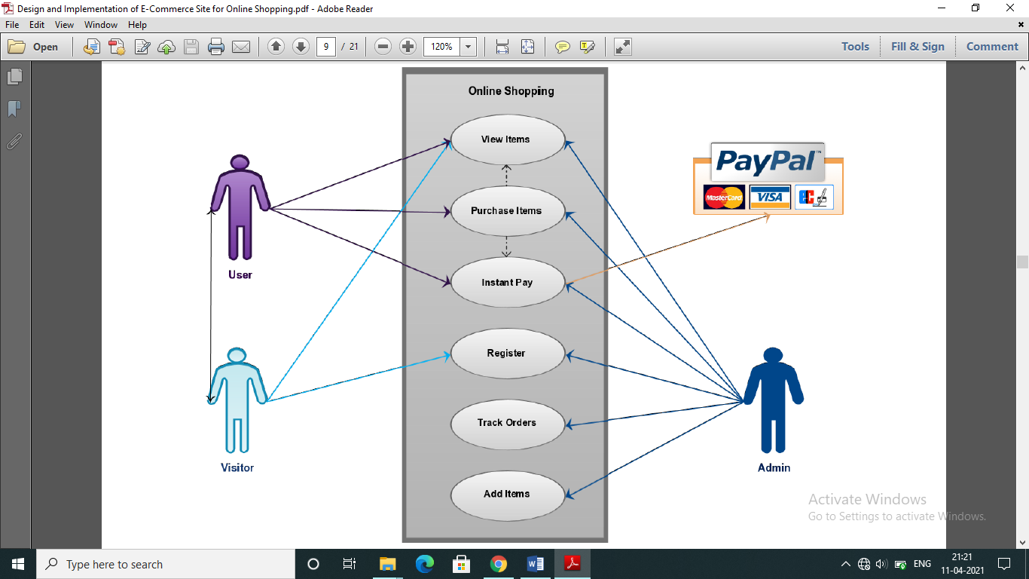
Use Case Diagram-

Slide 16
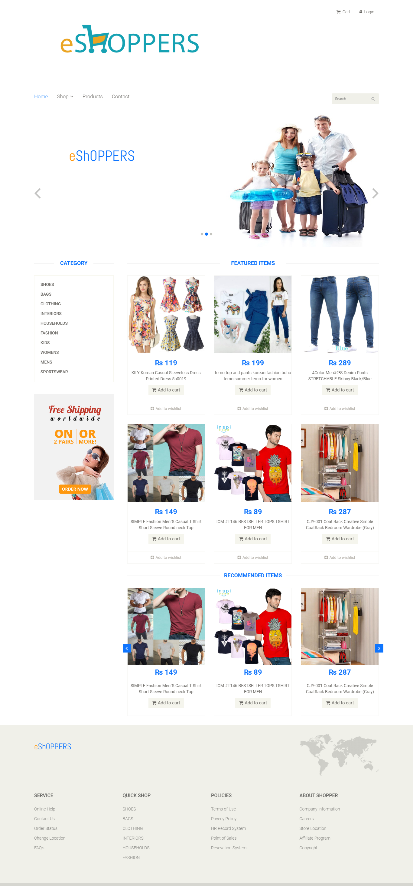
Screenshot
Of The
Front Page-

Slide 17
Benefits of E-Shoppers:
This site gives all the information about the e-shopping to provide better services to the customer.
It provides the facility to the customers who want to shop on-line due to lock of time.
It’s providing the full details about the product and related information about the product like cost, size etc.
With it’s help we can save both time and money.
It provides better security and good delivery service to the customer.

Slide 18
Conclusion-
This project entitled “E-Shoppers” is an implementation of the E-shopping or in other word shopping through Internet. It lets the user to place their order online for any article.
Future version of this software will still be much enhanced, than the current version 1.0, thus the “E-Shoppers”, is developed and executed successfully.

Slide 19
GitHub Repository Link for
E-Shoppers:
Link to Pratibha Dixit’s repository:
Link: https://github.com/pratibhadixit3990/E-Shoppers

Slide 20
References-
I referred to the following resources:
Course for Full-Stack Development on Udemy
Course Name: The Complete 2020 Web Development Bootcamp
Link:https://www.udemy.com/course/the-complete-web-development-bootcamp/
Attended By: Pratibha Dixit
Google Search
Our ongoing Full-Stack lectures and lab assignments
Website for Web-development: https://www.beta-labs.in/
Various YouTube videos

Slide 21
THANK YOU

